Slide 1
Decision Trees

Slide 2
Example
Sex | Salary | Afford cost | # of vehicles | Transport
M | 1000-3000 | 5 | 0 | Cab
M | 3000-5000 | 5 | 1 | Cab
F | 3000-5000 | 5 | 1 | Metro
F | 1000-3000 | 5 | 0 | Cab
M | 3000-5000 | 5 | 1 | Cab
M | 3000-5000 | 8 | 0 | Metro
F | 3000-5000 | 8 | 1 | Metro
F | 5000-8000 | 12 | 1 | Own
M | 3000-5000 | 12 | 2 | Own
F | 5000-8000 | 12 | 2 | Own

Slide 3
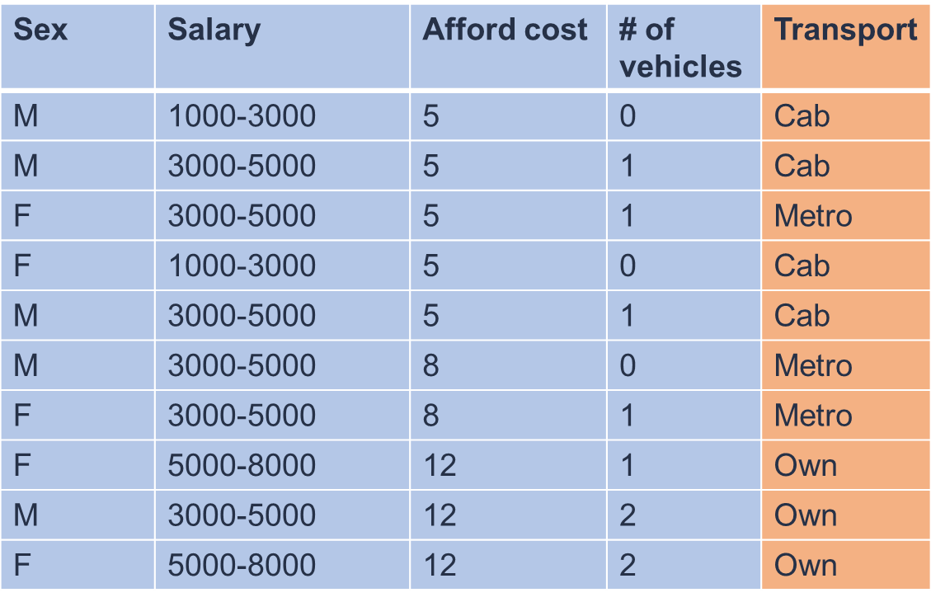
Intuitive Decision Tree
M
F
0
1

Slide 4
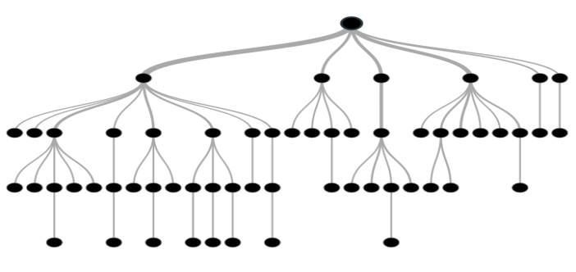
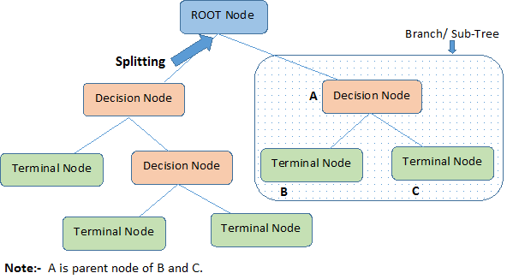
Decision Tree
Decision tree is a type of supervised learning algorithm (having a pre-defined target variable) that is mostly used in classification problems. It works for both categorical and continuous input and output variables. In this technique, we split the population or sample into two or more homogeneous sets (or sub-populations) based on most significant splitter / differentiator in input variables.
Root Node: It represents entire population or sample and this further gets divided into two or more homogeneous sets.
Splitting: It is a process of dividing a node into two or more sub-nodes.
Decision Node: When a sub-node splits into further sub-nodes, then it is called decision node.
Leaf/ Terminal Node: Nodes do not split is called Leaf or Terminal node.
Pruning: When we remove sub-nodes of a decision node, this process is called pruning. You can say it’s a opposite process of splitting.

Slide 5
Advantages and Disadvantages
Easy to Understand: Decision tree output is very easy to understand even for people from non-analytical background
Useful in Data exploration: Decision tree is one of the fastest way to identify most significant variables and relation between two or more variables. With the help of decision trees, we can create new variables / features that has better power to predict target variable. You can refer article (Trick to enhance power of regression model) for one such trick. It can also be used in data exploration stage. For example, we are working on a problem where we have information available in hundreds of variables, there decision tree will help to identify most significant variable.
Less data cleaning required: It requires less data cleaning compared to some other modelling techniques. It is not influenced by outliers and missing values to a fair degree.
Data type is not a constraint: It can handle both numerical and categorical variables.
Non Parametric Method: Decision tree is considered to be a non-parametric method. This means that decision trees have no assumptions about the space distribution and the classifier structure.
Over fitting: Over fitting is one of the most practical difficulty for decision tree models. This problem gets solved by setting constraints on model parameters and pruning (discussed in detailed below).
Not fit for continuous variables: While working with continuous numerical variables, decision tree looses information when it categorizes variables in different categories.

Slide 6

Decision Trees

Slide 7
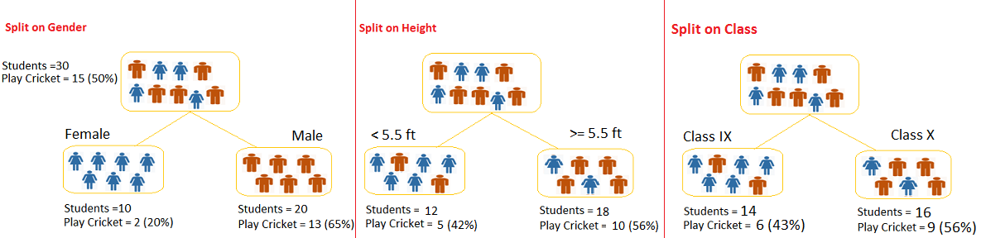
How does a tree decide where to split?
Let’s say we have a sample of 30 students with three variables Gender (Boy/ Girl), Class( IX/ X) and Height (5 to 6 ft). 15 out of these 30 play cricket in leisure time. Now, I want to create a model to predict who will play cricket during leisure period? In this problem, we need to segregate students who play cricket in their leisure time based on highly significant input variable among all three.
Decision tree will segregate the students based on all values of three variable and identify the variable, which creates the best homogeneous sets of students (which are heterogeneous to each other). In the snapshot below, you can see that variable Gender is able to identify best homogeneous sets compared to the other two variables.

Slide 8
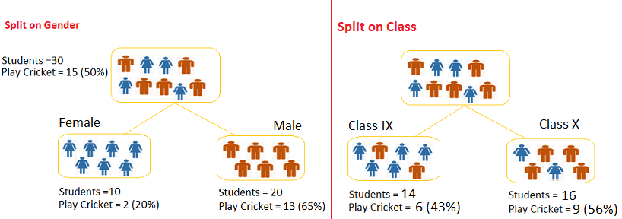
Gini Index
Steps to Calculate Gini for a split
Calculate Gini for sub-nodes, using formula sum of square of probability for success and failure (p^2+q^2). p and q is probability of success and failure respectively
Calculate Gini for split using weighted Gini score of each node of that split
Split on Gender:
Calculate, Gini for sub-node Female = (0.2)*(0.2)+(0.8)*(0.8)=0.68
Gini for sub-node Male = (0.65)*(0.65)+(0.35)*(0.35)=0.55
Calculate weighted Gini for Split Gender = (10/30)*0.68+(20/30)*0.55 = 0.59
Similar for Split on Class:
Gini for sub-node Class IX = (0.43)*(0.43)+(0.57)*(0.57)=0.51
Gini for sub-node Class X = (0.56)*(0.56)+(0.44)*(0.44)=0.51
Calculate weighted Gini for Split Class = (14/30)*0.51+(16/30)*0.51 = 0.51
Above, you can see that Gini score for Split on Gender is higher than Split on Class, hence, the node split will take place on Gender.
Higher the value of Gini higher the homogeneity. Here Split will occur at Gender first
CART (Classification and Regression Tree) uses Gini method to create binary splits.

Slide 9
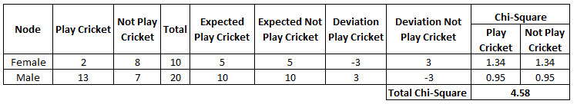
Chi-Square
We measure Chi Square by sum of squares of standardized differences between observed and expected frequencies of target variable.
Chi-square = ((Actual – Expected)^2 / Expected)^1/2
Split on Gender:
First we are populating for node Female, Populate the actual value for “Play Cricket” and “Not Play Cricket”, here these are 2 and 8 respectively.
Calculate expected value for “Play Cricket” and “Not Play Cricket”, here it would be 5 for both because parent node has probability of 50% and we have applied same probability on Female count(10).
Calculate deviations by using formula, Actual – Expected. It is for “Play Cricket” (2 – 5 = -3) and for “Not play cricket” ( 8 – 5 = 3).
Calculate Chi-square of node for “Play Cricket” and “Not Play Cricket” using formula with formula, = ((Actual – Expected)^2 / Expected)^1/2.
Follow similar steps for calculating Chi-square value for Male node.
Now add all Chi-square values to calculate Chi-square for split Gender.

Slide 10
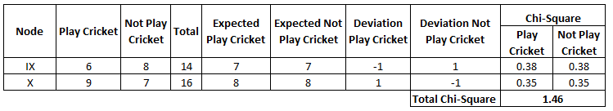
Chi Square
Split on Class:
Perform similar steps of calculation for split on Class and you will come up with below table.
Above, you can see that Chi-square also identify the Gender split is more significant compare to Class.

Slide 11
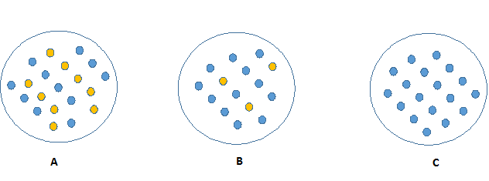
Information Gain
C requires can be described easily because it requires less information as all values are similar.
On the other hand, B requires more information to describe it and A requires the maximum information.
In other words, we can say that C is a Pure node, B is less Impure and A is more impure.
In Information theory a measure this degree of disorganization in a system is known as Entropy.
If the sample is completely homogeneous, then the entropy is zero and if the sample is an equally divided (50% – 50%), it has entropy of one.
Entropy can be calculated using formula:-
Here p and q is probability of success and failure respectively in that node.
Entropy is also used with categorical target variable. It chooses the split which has lowest entropy compared to parent node and other splits. The lesser the entropy, the better it is.

Slide 12
Entropy Calculation
Calculate entropy of parent node
Calculate entropy of each individual node of split and calculate weighted average of all sub-nodes available in split.
Entropy for parent node = -(15/30) log2 (15/30) – (15/30) log2 (15/30) = 1.
Here 1 shows that it is a impure node.
Entropy for Female node = -(2/10) log2 (2/10) – (8/10) log2 (8/10) = 0.72
and for male node, -(13/20) log2 (13/20) – (7/20) log2 (7/20) = 0.93
Entropy for split Gender = Weighted entropy of sub-nodes
= (10/30)*0.72 + (20/30)*0.93 = 0.86
Entropy for Class IX node, -(6/14) log2 (6/14) – (8/14) log2 (8/14) = 0.99
and for Class X node, -(9/16) log2 (9/16) – (7/16) log2 (7/16) = 0.99.
Entropy for split Class =
(14/30)*0.99 + (16/30)*0.99 = 0.99
Above, you can see that entropy for Split on Gender is the lowest among all, so the tree will split on Gender.
We can derive information gain from entropy as 1- Entropy.

Slide 13

Variance
Reduction in Variance
Till now, we have discussed the algorithms for categorical target variable. Reduction in variance is an algorithm used for continuous target variables (regression problems). This algorithm uses the standard formula of variance to choose the best split. The split with lower variance is selected as the criteria to split the population:
Above X-bar is mean of the values, X is actual and n is number of values.
Steps to calculate Variance:
Calculate variance for each node.
Calculate variance for each split as weighted average of each node variance.

Slide 14
Variance Calculation
Let’s assign numerical value 1 for play cricket and 0 for not playing cricket. Now follow the steps to identify the right split:
Variance for Root node, here mean value is (15*1 + 15*0)/30 = 0.5 and we have 15 one and 15 zero. Now variance would be ((1-0.5)^2+(1-0.5)^2+….15 times+(0-0.5)^2+(0-0.5)^2+…15 times) / 30, this can be written as (15*(1-0.5)^2+15*(0-0.5)^2) / 30 = 0.25
Mean of Female node = (2*1+8*0)/10=0.2 and Variance = (2*(1-0.2)^2+8*(0-0.2)^2) / 10 = 0.16
Mean of Male Node = (13*1+7*0)/20=0.65 and Variance = (13*(1-0.65)^2+7*(0-0.65)^2) / 20 = 0.23
Variance for Split Gender = Weighted Variance of Sub-nodes = (10/30)*0.16 + (20/30) *0.23 = 0.21
Mean of Class IX node = (6*1+8*0)/14=0.43 and Variance = (6*(1-0.43)^2+8*(0-0.43)^2) / 14= 0.24
Mean of Class X node = (9*1+7*0)/16=0.56 and Variance = (9*(1-0.56)^2+7*(0-0.56)^2) / 16 = 0.25
Variance for Split Gender = (14/30)*0.24 + (16/30) *0.25 = 0.25
Above, you can see that Gender split has lower variance compare to parent node, so the split would take place on Gender variable.

